Slide 1
Hierarchical Latent Models Bi-Factor Models
Kline Chapter 9
Beaujean Chapter 9

Slide 2
Naming
Hierarchical:
Structured into an order or rank
Higher-order:
Describes when latent variables are structured so that latents influence other latents into levels
Bi-factor
Generally used to describe a CFA with two sets of latent variables (not hierarchical)

Slide 3
Hierarchical Models
The idea of a higher order model is:
You have some latent variables that are measured by the observed variables
A portion of the variance in the latent variables can be explained by a second (set) of latent variables

Slide 4
Hierarchical Models
Therefore, we are switching out the covariances between factors and using another latent to explain them.

Slide 5
Hierarchical Models
When are these used?
When there are multiple latent variables that covary with each other (and a lot)
A second set of latents explains that covariance

Slide 6
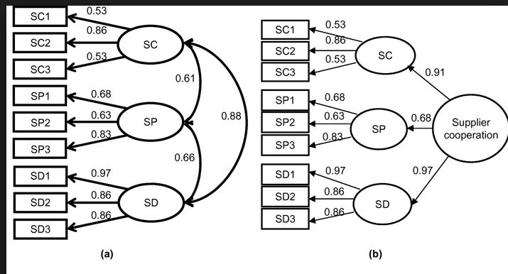

Slide 7
Hierarchical Models
The covariance of the first order is accounted for by the second order plus a specific factor
Specific factors are error that is not explained by the second order latents.
The higher order is thought to indirectly influence the manifest variables through the first order.

Slide 8
Identification
Remember that each portion of the model has to be identified.
The section with each latent variable has to be identified (so you need at least one loading or LV set to 1).
The section with the latents has to be identified

Slide 9
Identification
You can achieve identification in a couple of ways:
Set some of the loadings in the upper portion of the model to be equal (give them the same name)
You can set the variance in the upper latent to be 1
You can set some of the error variances of the latents in the lower portion to be equal

Slide 10
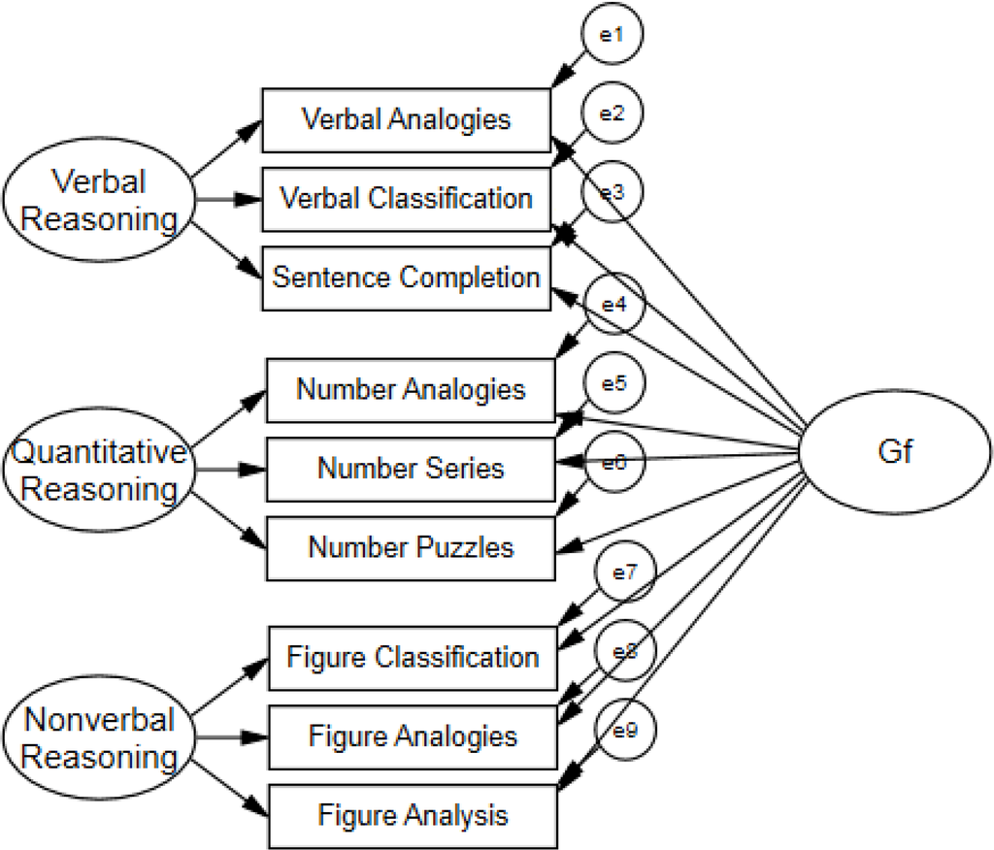

Slide 11
Bi-Factor Models
Special type of model with two sets of latents, but they are not hierarchically structured.
Best used when:
General factor that accounts for variance in the manifest variables
Domain specific areas that are thought to influence the manifest variables

Slide 12
Bi-Factor Models
One thing to note is that the latent variables are left uncorrelated in this type of model.
This structure represents the domain specific part of the interpretation.

Slide 13
Model Differences
Differences between bi-factor and hierarchical:
In hierarchical models, the second order influences the first order, while the two sets of latents in bi-factors are uncorrelated.
What does that allow you to test differently?

Slide 14
Model Differences
Advantages:
Allows you to see how the first order LVs influence the manifest variables separately from the other LVs.
After accounting for the general LV, are the domain specific items still accounting for variance?
You can compare models with and without the domain specific areas.

